Slide 1
Death rate analysis
Course : Data Science Lab – l
Guidance : Dr. Dootika Vats

Slide 2

Data for the project

Slide 3

Kind of data
We have collected death rates due to various causes of different countries.
WHO's global heath estimates provides latest available data on cause of death
Human Development Index(HDI) and GDP(Gross Domestic Product) for different countries.

Slide 4

Data collection and sources
Major part of the data, i.e. , Death rates of various countries was extracted using an API. The GHO(Global Health Observatory) portal provides a simple query interface to the World Health Organization's data and statistics content, using OData (Open Data Protocol).
Data of Human Development Index was scraped from countryeconomy.com and that of GDP is collected in form of csv file from World Bank website.
References:
https://data.worldbank.org/indicator/NY.GDP.MKTP.KD.ZG
https://countryeconomy.com/hdi?year=2004
https://www.who.int/data/gho/data/indicators/indicators-index

Slide 5
Features of data
Raw extracted data from the WHO website had around 122 data sets
Our Final data for death rates is a list of 18 data frames of different causes of deaths. Each data frame has 5 columns and 453 rows. Different columns represent Country code, Gender, Death rate, Country, Region.
Data set for GDP consists of 181 rows and 2 columns for Country codes and GDP values.
Data set for HDI consists of 172 countries and 2 columns for Country codes and HDI values.

Slide 6
Challenges faced
problems
SOLUTIONS
We used GHO’s Odata API.
We used the filter that the ‘Indicator name’ (name of the data set) should contain the word ‘death’. Which gave us a list of 122 data frames.
We hand picked data such that we have maximum causes with maximum countries. As a result, we ended up with data frames which had death rate for the year 2004. The year 2004 also had gender wise data unlike some other years.
We refined the data frames such that they contained only intersection of all the countries available
The first challenge we faced was that the websites didn’t allow we scraping.
WHO website had a simple API interface. The API gave access to loads of data.
All the data frames were not useful. Different data frames had data for different periods of time, and a lot of data had missing values.
Not all data sets of 2004 had same number of countries

Slide 7




What are we going to analyze ?
Are there any anomalies ?
What is relation between hdi , gdp and death rate ?
Does some other factor affect the death rate in certain countries ?
What role does gender play in causes of death

Slide 8
Insightful visualizations and Interesting questions

Slide 9
Listing some Interesting questions
Alcohol and Breast cancer
East Mediterranean anomaly
Colon and rectum cancer
Diabetes mellitus in females
Cerebrovascular diseases
Why do these two causes have no correlation with GDP and HDI?
How does socio-economic conditions of countries effect the death rates of a class of people?
Do things like knowledge of existence of disease effect the reporting of deaths due that disease?
How does socio-economic conditions effect death rates of a particular disease?
Do lifestyle and food habits have a relationship with HDI and GDP?
Notes:
Primary cause is high cholesterol levels and it has negative correlation with HDI and GDP

Slide 10
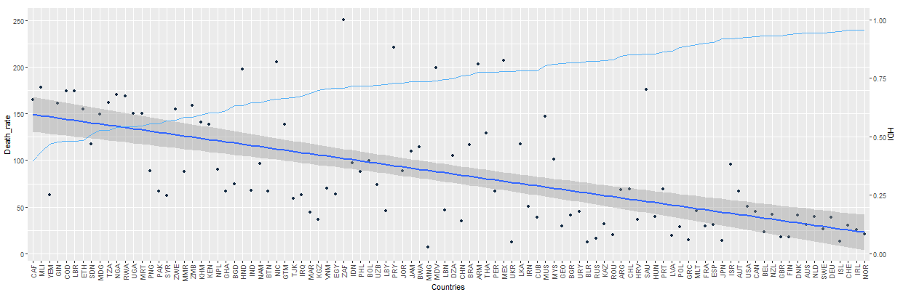
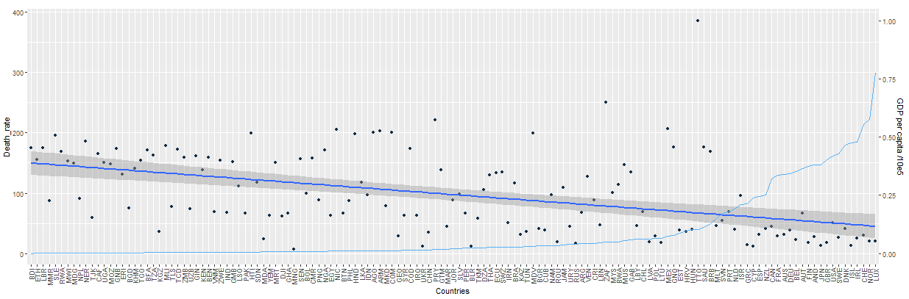
Plots Of Diabetes mellitus with HDI and GDP
Diabetes mellitus shows a negative correlation with both HDI and GDP
Possible reasons:
Ignorance of treatment
Health care facilities
Poverty -> lifestyle
Use of alternative therapy
Notes:
We might speculate about why more developed countries or countries with more gdp have lower death rates due to diabetes mellitus. We think that some reasons that differentiate of

Slide 11
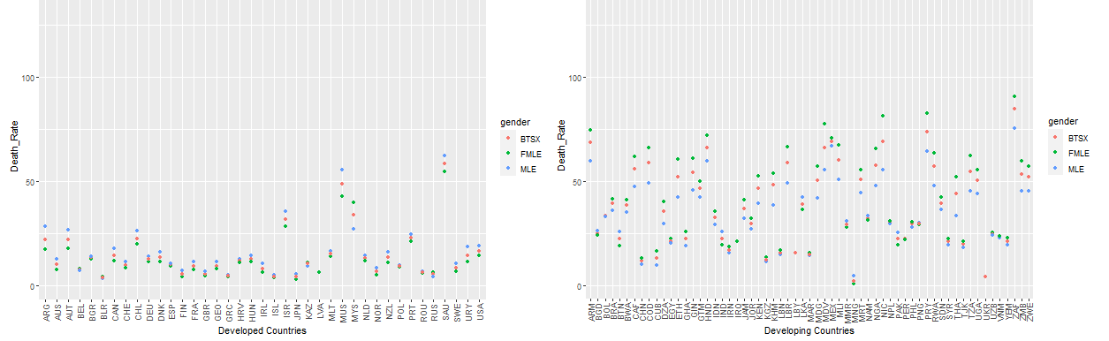
Death rate due to diabetes vs countries
We observe a clear female dominance in death rates of Developing countries unlike in Developed countries
Possible reason : As obesity among women increases, diabetes in pregnancy is becoming increasingly common in LMIC(Low and Low-middle income countries). Because of lack of resources and trained personnel, and other priorities related to reducing maternal, feotal, and neonatal mortality, diagnosing and providing care to women with diabetes in pregnancy is not high on the priority lists in many LMIC.
Notes:
Developed developing HDI .8 , As obesity among women increases, diabetes in pregnancy is becoming increasingly common in LMIC. Because of lack of resources and trained personnel, and other priorities related to reducing maternal, fetal, and neonatal mortality, diagnosing and providing care to women with diabetes in pregnancy is not high on the priority lists in many LMIC.

Slide 12
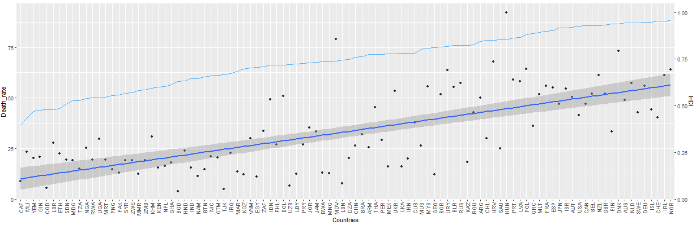
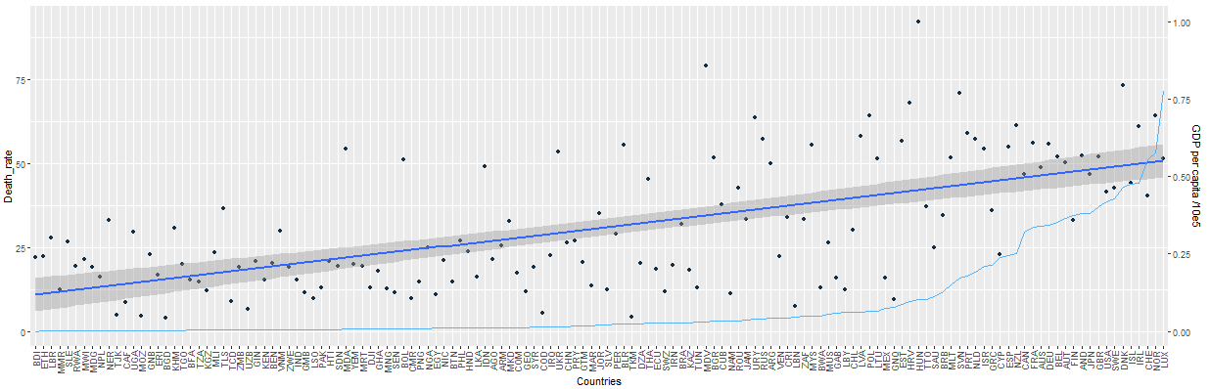
Plots OF Colon And Rectum cancer with HDI and GDP
Colon and rectum cancer plots with HDI and GDP are quite unusual with respect to other data sets.
Possible reasons :
Ignorance of existence of diseases
Mortality to incidence ratio
Notes:
mortality to incidence ratio is negatively co- related with hdi and gdp)
Ignorance of the existence of disease so cause of death due to this may not be reported

Slide 13
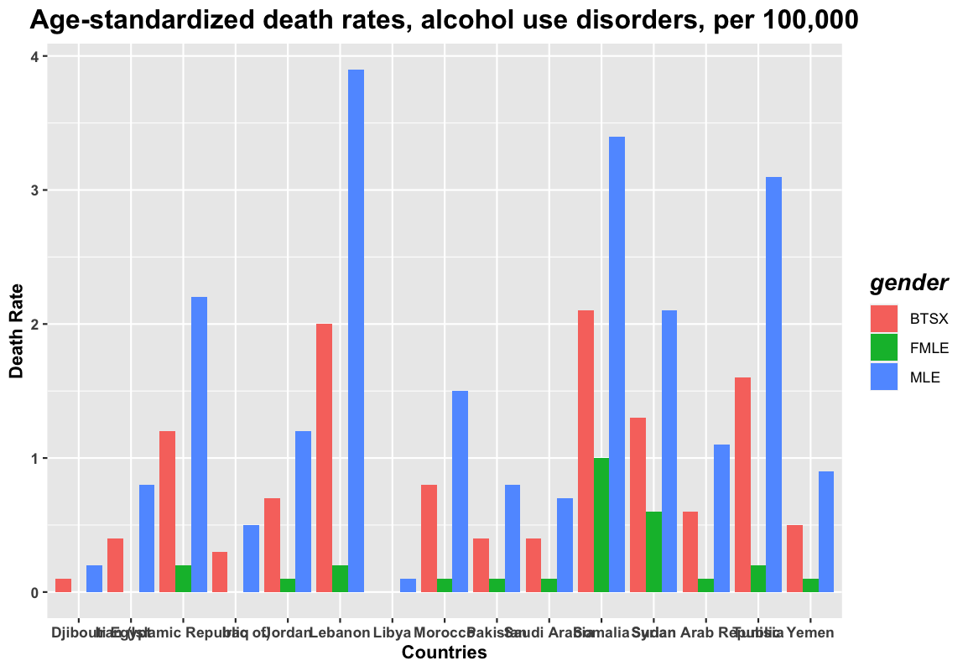
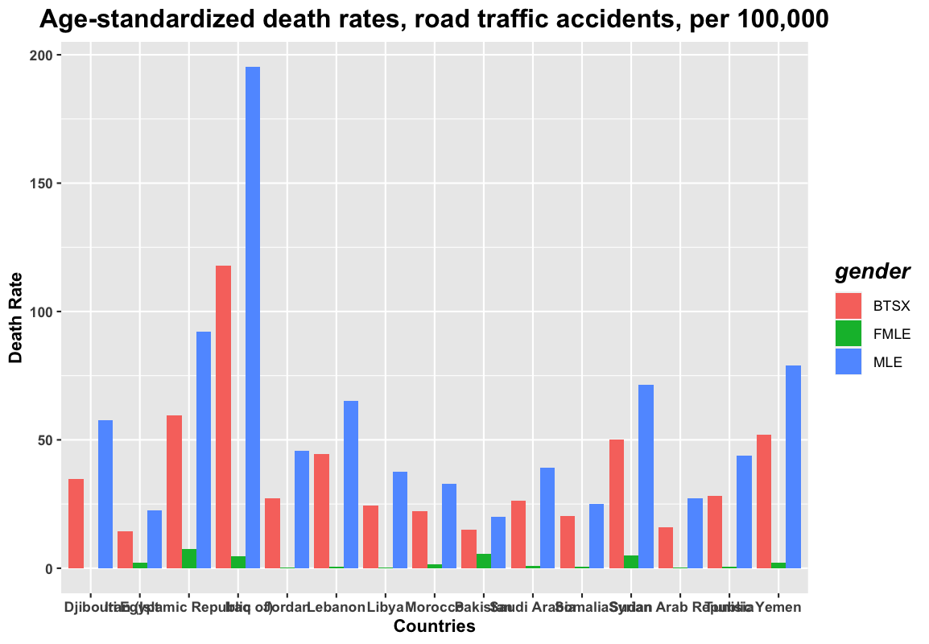
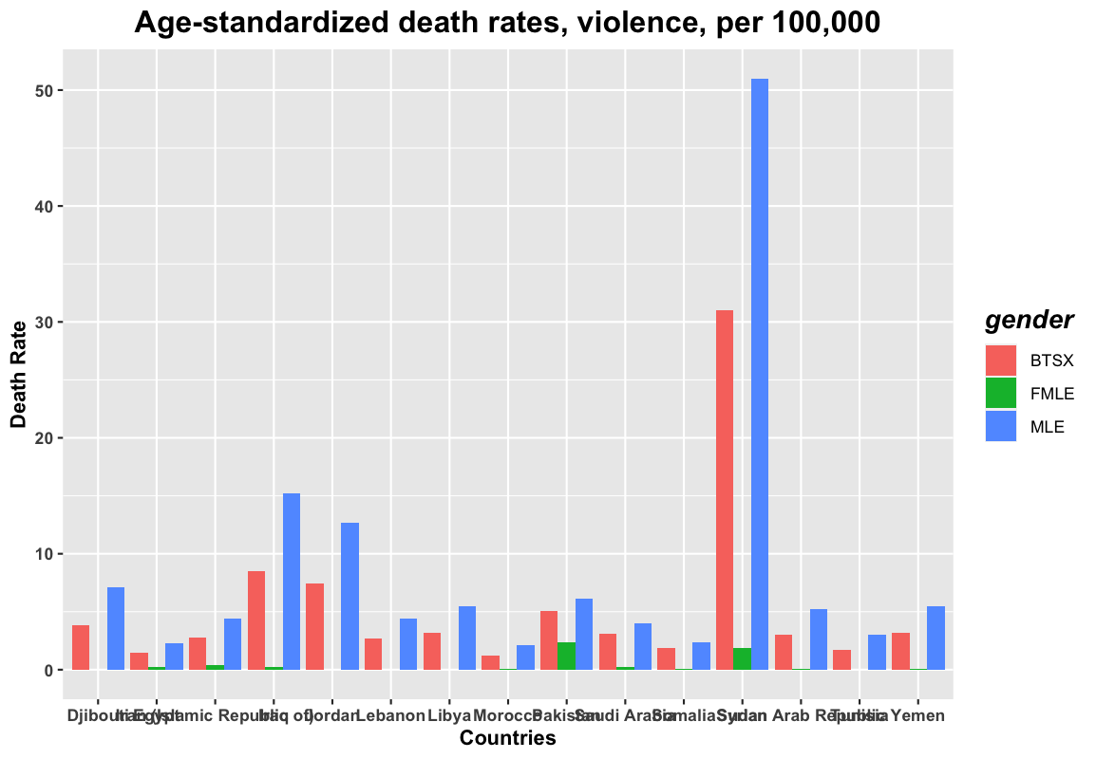
anomalies with east Mediterranean
Due to Laws in these East Mediterranean Countries
And Less Independence of Women, The
corresponding plots for Alcohol , Road Traffic
And Violence related deaths can be
understood.

Slide 14
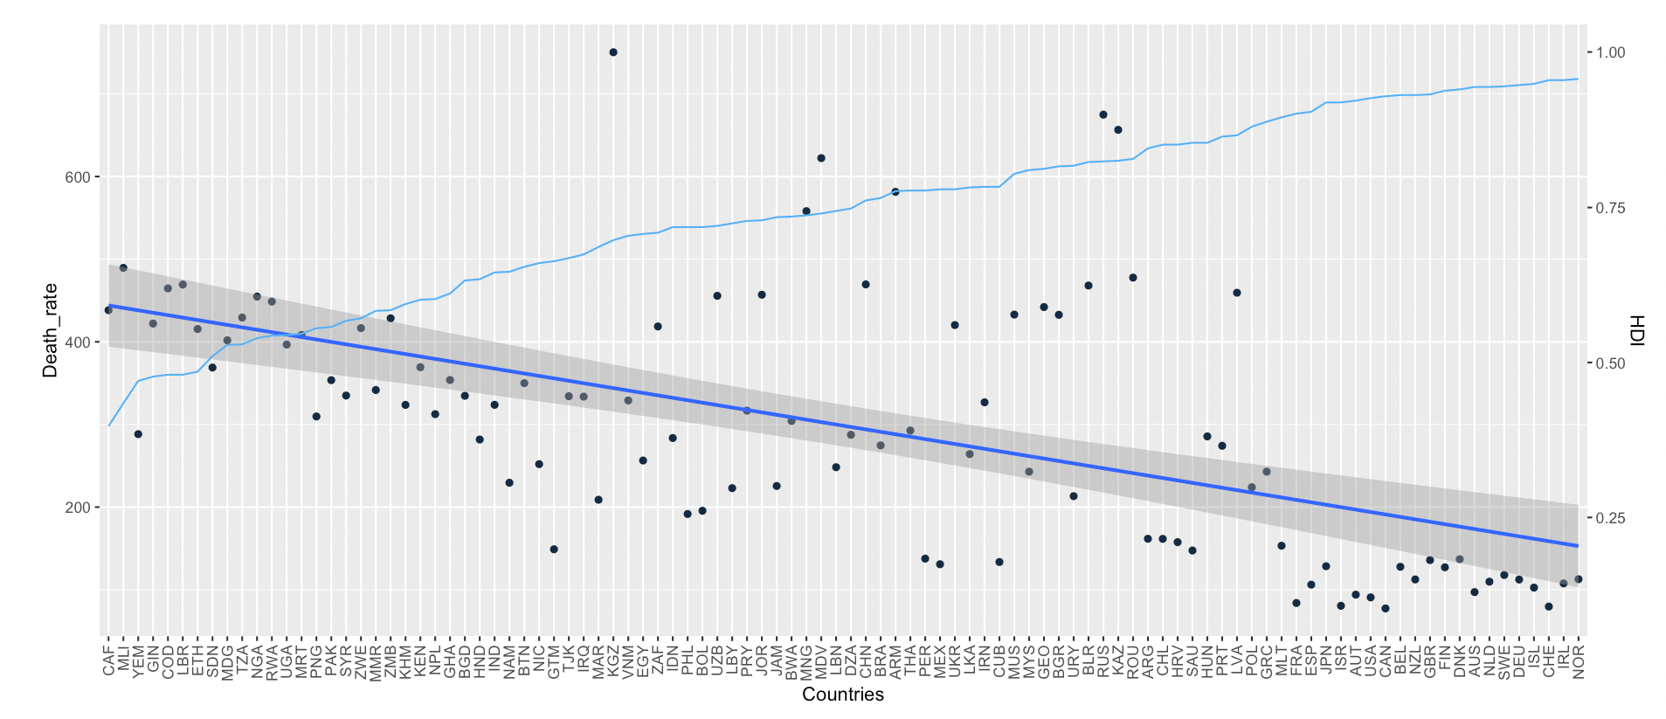
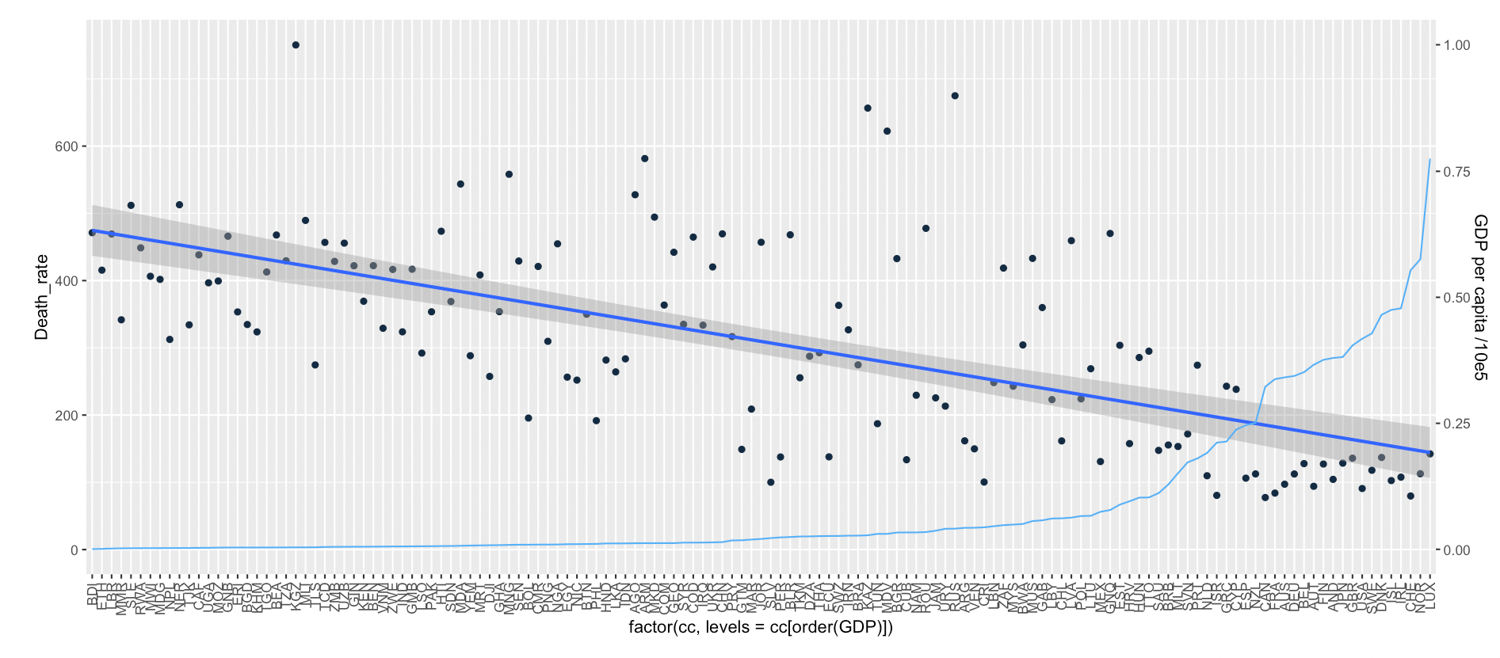
Plots Of Cerebrovascular diseases with HDI and GDP
Death rates due to cerebrovascular diseases shows negative correlation with HDI and GDP
Possible reasons :
Cerebrovascular diseases are primarily caused by high cholesterol levels. So there might be some relation between GDP HDI and lifestyle in such a way that general cholesterol levels of the people are lower in countries with higher GDP and HDI

Slide 15
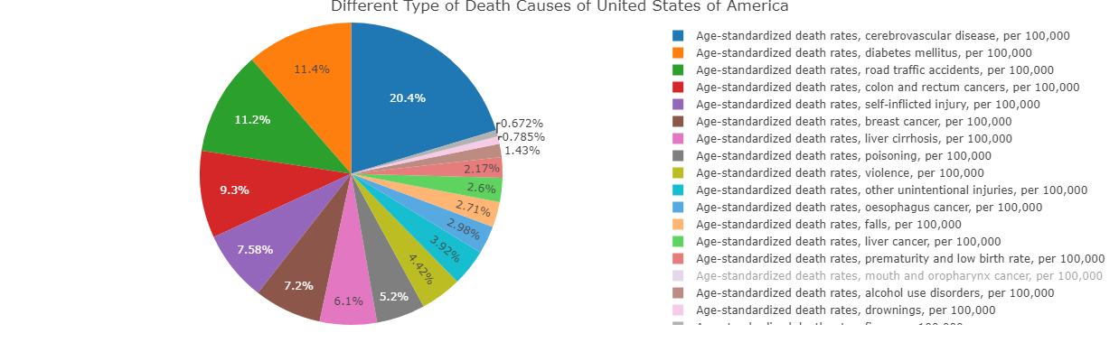
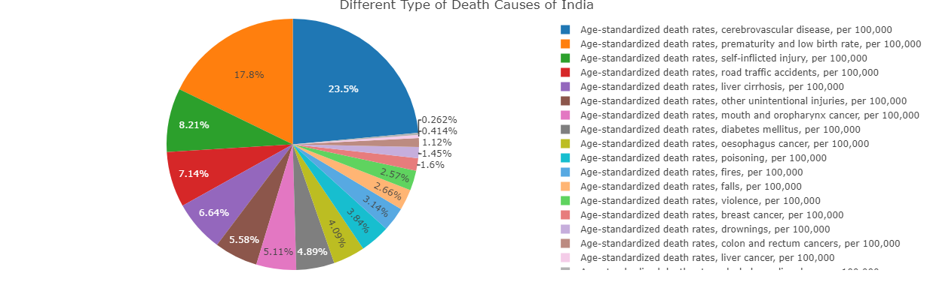
Pie chart analysis
1.Death rate for Cerebrovascular is highest in all countries.
2. Percentage of Premature and low birth rate is higher in developing countries than developing countries.
Possible Reasons:
Substance Abuse before Pregnancy.
Malnutrition.

Slide 16
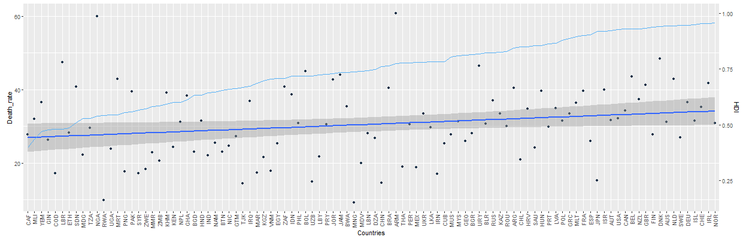
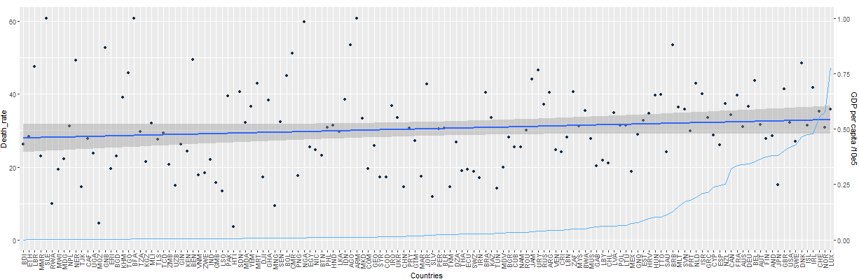
Plots Of Breast Cancer with HDI and GDP
Death rates due to Breast cancer shows no correlation with HDI and GDP

Slide 17

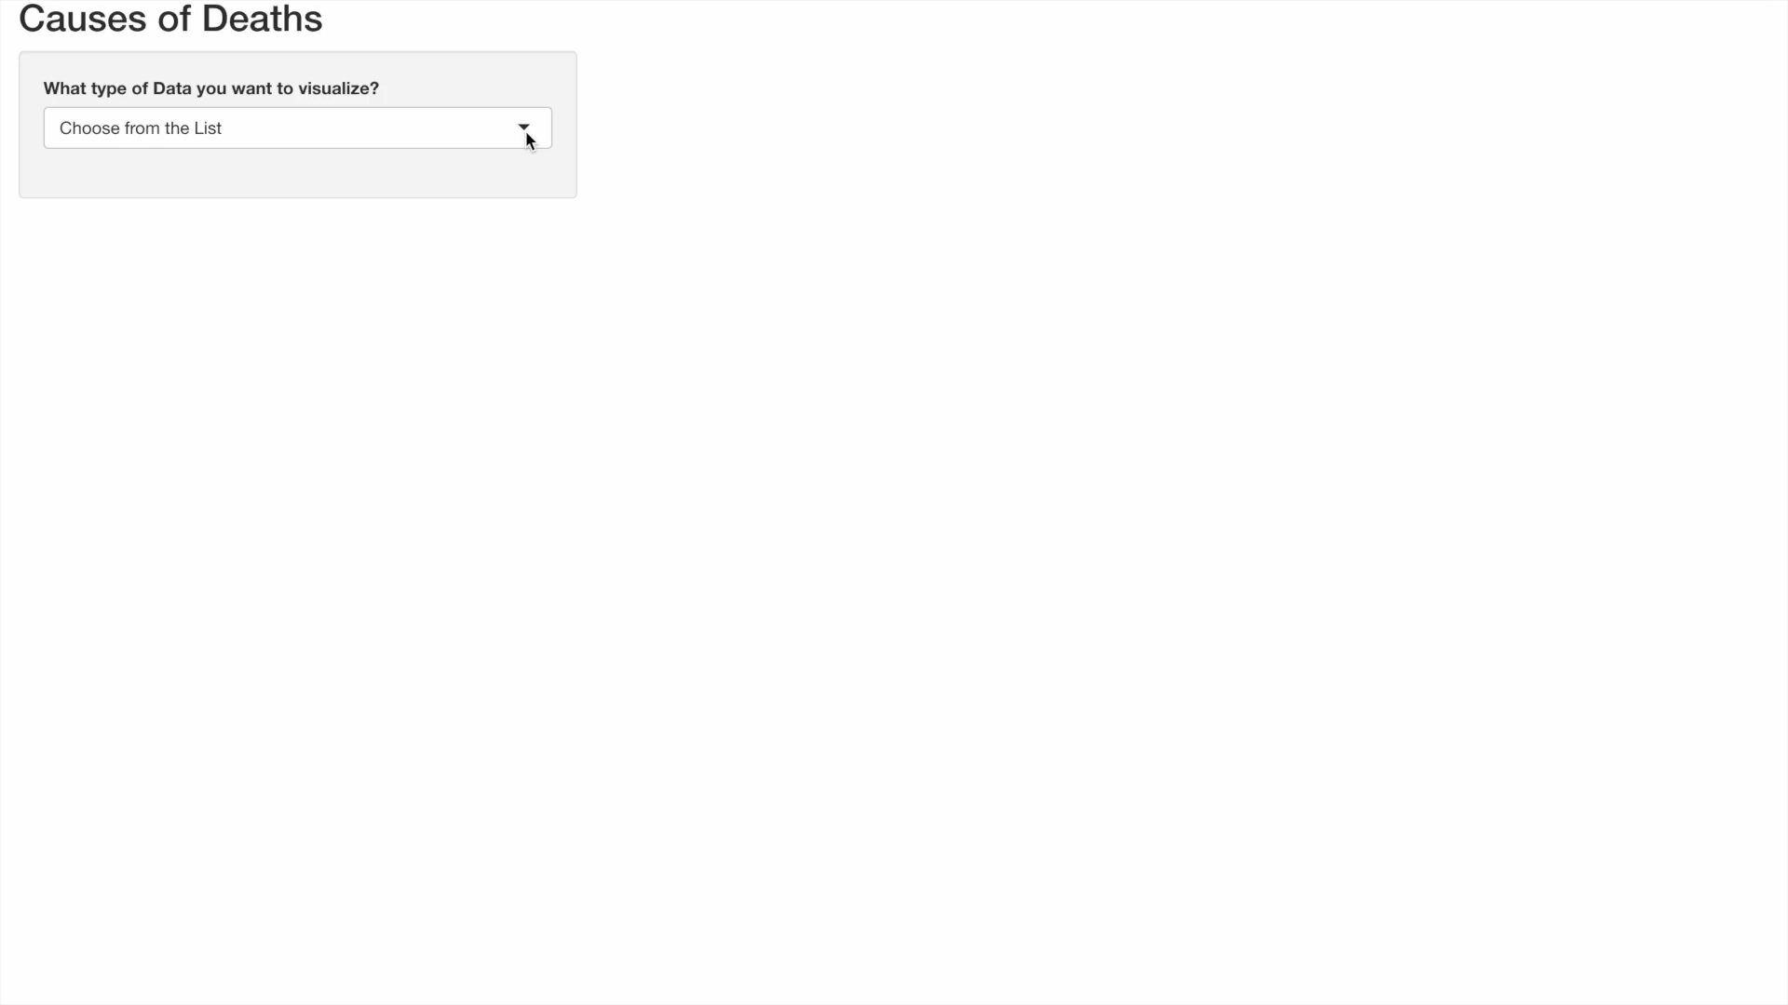
SHIny App

Slide 18
Biases?
Biases in our data might have aroused due to methods used in cleaning of data
There might have been bias due to lack of proper survey in developing countries
Not all bisexual people reveal there gender due to social conditions so the data might be biased against bisexual gender
Notes:
Data cleaned by intersection method maybe some less popular less developed countries got lost

Slide 19
—DR. Dootika vats
“OKAY”

Slide 20
thanks
Team members :
Pankajh Jhamtani
Gaurish Bansal
Anirban Ghosh
Digvijay Sarak-Patil

